Slide 1
Table of Contents
This slide deck consists of slides used in 2 lecture videos in Week 3. Below is a list of shortcut hyperlinks for you to jump into specific sections.
(page 2) Week 3: JavaScript Object Oriented Concepts
(page 10) Week 3: JavaScript Object Oriented Classes
Notes:
Note from Chuck. If you are using these materials, you can remove my name and URL from this replace it with your own, but please retain the CC-BY logo on the first page as well as retain the entire last page when you remix and republish these slides.
TO Highlight – go to https://tohtml.com/html/ - paste and then do a "Paste RTF"

Slide 2

Object Oriented Programming in JavaScript
Dr. Charles Severance
www.dj4e.com
http://www.dj4e.com/code/javascript-objects
http://www.dj4e.com/code/javascript-objects.zip

Slide 3
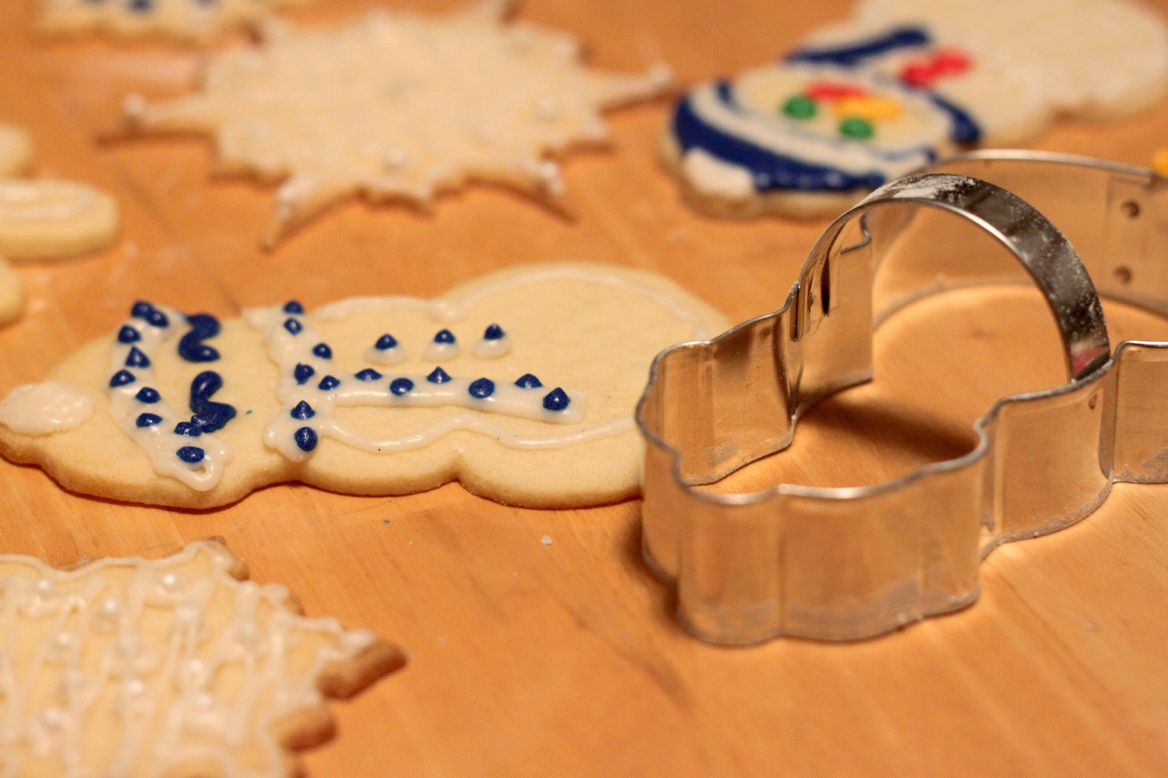
Definitions
Class - a template - Dog
Method or Message - A defined capability of a class - bark()
Attribute - A defined data item in a class - color
Object or Instance - A particular instance of a class - Lassie
Image CC-By 2.0: https://www.flickr.com/photos/dinnerseries/23570475099

Slide 4
Terminology: Class
Defines the abstract characteristics of a thing (object), including the thing's characteristics (its attributes, fields, or properties) and the thing’s behaviors (the things it can do, or methods, operations, or features). One might say that a class is a blueprint or factory that describes the nature of something. For example, the class Dog would consist of traits shared by all dogs, such as breed and fur color (characteristics), and the ability to bark and sit (behaviors).
http://en.wikipedia.org/wiki/Object-oriented_programming

Slide 5
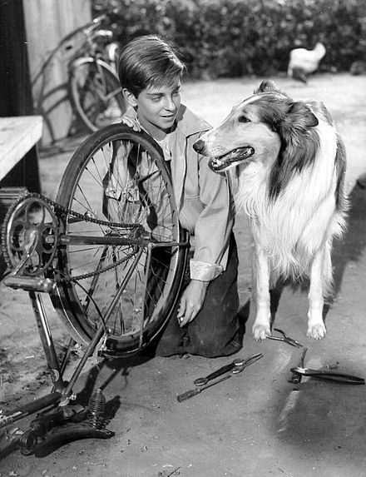
Terminology: Class
A pattern (exemplar) of a class. The class of Dog defines all possible dogs by listing the characteristics and behaviors they can have; the object Lassie is one particular dog, with particular versions of the characteristics. A Dog has fur; Lassie has brown-and-white fur.
http://en.wikipedia.org/wiki/Object-oriented_programming

Slide 6
Terminology: Instance
One can have an instance of a class or a particular object. The instance is the actual object created at runtime. In programmer jargon, the Lassie object is an instance of the Dog class. The set of values of the attributes of a particular object is called its state. The object consists of state and the behavior that’s defined in the object’s class.
Object and Instance are often used interchangeably.
http://en.wikipedia.org/wiki/Object-oriented_programming

Slide 7
Terminology: Method
An object’s abilities. In language, methods are verbs. Lassie, being a Dog, has the ability to bark. So bark() is one of Lassie’s methods. She may have other methods as well, for example sit() or eat() or walk() or save_timmy(). Within the program, using a method usually affects only one particular object; all Dogs can bark, but you need only one particular dog to do the barking
Method and Message are often used interchangeably.
http://en.wikipedia.org/wiki/Object-oriented_programming

Slide 8
Objects in JavaScript
The OO pattern in JavaScript is a little different.
The function is indeed a store and reuse pattern.
The function keyword returns a value which is the function itself - it makes a function!

Slide 9
First-Class Functions
In computer science, a programming language is said to have first-class functions if it treats functions as first-class citizens. Specifically, this means the language supports passing functions as arguments to other functions, returning them as the values from other functions, and assigning them to variables or storing them in data structures.
http://en.wikipedia.org/wiki/First-class_function

Slide 10
A Sample Class

Slide 11
js01.htm
function PartyAnimal() {
this.x = 0;
this.party = function () {
this.x = this.x + 1;
console.log("So far "+this.x);
}
}
an = new PartyAnimal();
an.party();
an.party();
an.party();
This is the template for making PartyAnimal objects.
Each PartyAnimal object has a bit of data.
Each PartyAnimal object has a bit of code.
Create a PartyAnimal object
Tell the object to run the party() code.
js01.htm

Slide 12
js-01.htm
function PartyAnimal() {
this.x = 0;
this.party = function () {
this.x = this.x + 1;
console.log("So far "+this.x);
}
}
an = new PartyAnimal();
an.party();
an.party();
an.party();
an
x:
party()
So far 1
So far 2
So far 3
js-01.htm

Slide 13
Object Life Cycle
http://en.wikipedia.org/wiki/Constructor_(computer_science)

Slide 14
Object Life Cycle
Objects are created, used, and discarded
Constructors are implicit in JavaScript - natural
A constructor in a class is a special block of statements called when an object is created
Destructors are not provided by JavaScript
http://en.wikipedia.org/wiki/Constructor_(computer_science)

Slide 15
js03.htm
function PartyAnimal() {
this.x = 0;
console.log("In the 'constructor'");
this.party = function () {
this.x = this.x + 1;
console.log("So far "+this.x);
}
}
an = new PartyAnimal();
an.party();
an.party();
an.party();
js03.htm
In the 'constructor'
So far 1
So far 2
So far 3

Slide 16
Many Instances
We can create lots of objects - the class is the template for the object.
We can store each distinct object in its own variable.
We call this having multiple instances of the same class.
Each instance has its own copy of the instance variables.

Slide 17
js04.htm
Constructors can have additional parameters. These can be used to set up instance variables for the particular instance of the class (i.e., for the particular object).
function PartyAnimal(nam) {
this.x = 0;
this.name = nam;
console.log("Built "+nam);
this.party = function () {
this.x = this.x + 1;
console.log(nam+"="+this.x);
}
}
s = new PartyAnimal("Sally");
s.party();
j = new PartyAnimal("Jim");
j.party();
s.party();
Built Sally
Sally=1
Built Jim
Jim=1
Sally=2
js04.htm

Slide 18
js04.htm
s
function PartyAnimal(nam) {
this.x = 0;
this.name = nam;
console.log("Built "+nam);
this.party = function () {
this.x = this.x + 1;
console.log(nam+"="+this.x);
}
}
s = new PartyAnimal("Sally");
s.party();
j = new PartyAnimal("Jim");
j.party();
s.party();
x:
name:
Built Sally
Sally=1
js04.htm

Slide 19
js04.htm
s
function PartyAnimal(nam) {
this.x = 0;
this.name = nam;
console.log("Built "+nam);
this.party = function () {
this.x = this.x + 1;
console.log(nam+"="+this.x);
}
}
s = new PartyAnimal("Sally");
s.party();
j = new PartyAnimal("Jim");
j.party();
s.party();
x:
name:
j
x:
name:
Built Sally
Sally=1
Built Jim
Jim=1
Sally=2
js04.htm

Slide 20
Definitions
Class - a template - Dog
Method or Message - A defined capability of a class - bark()
Object or Instance - A particular instance of a class - Lassie
Constructor - A method which is called when the instance / object is created

Slide 21
Summary
The key for this lecture is to understand how to read OO documentation for JavaScript and how to use objects.
Building brand new complex objects is more advanced.
It is important to remember that JavaScript uses objects as its “Associative Array”.

Slide 22
Acknowledgements / Contributions
These slides are Copyright 2010- Charles R. Severance (www.dr-chuck.com) as part of www.dj4e.com and made available under a Creative Commons Attribution 4.0 License. Please maintain this last slide in all copies of the document to comply with the attribution requirements of the license. If you make a change, feel free to add your name and organization to the list of contributors on this page as you republish the materials.
Initial Development: Charles Severance, University of Michigan School of Information
Insert new Contributors and Translators here including names and dates
Continue new Contributors and Translators here
Notes:
Note from Chuck. Please retain and maintain this page as you remix and republish these materials. Please add any of your own improvements or contributions.

Slide 23
Additional Source Information
“Snowman Cookie Cutter” by Didriks is licensed under CC BY https://www.flickr.com/photos/dinnerseries/23570475099
Photo from the television program Lassie. Lassie watches as Jeff (Tommy Rettig) works on his bike is Public Domain https://en.wikipedia.org/wiki/Lassie - /media/File:Lassie_and_Tommy_Rettig_1956.JPG

